Slide 1
CENG 538 Advanced Graphics and UIs
Images, Display, Perception

Slide 2
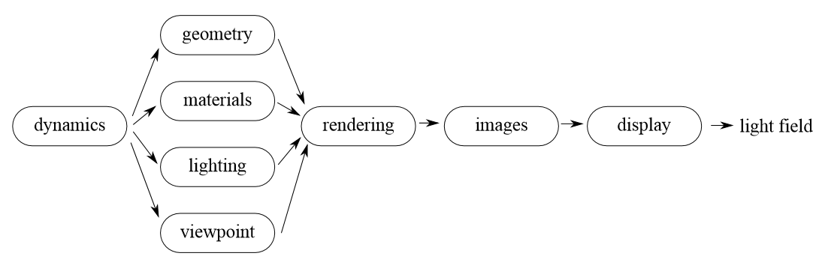
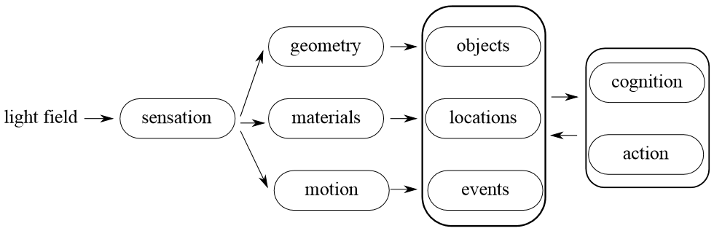
Pipeline Recap

Slide 3
Display Hardware
Video display devices
Cathode Ray Tube (CRT)
Liquid Crystal Display (LCD)
Light-emitting Diodes (LED)
https://www.youtube.com/watch?v=_O-2D5ryb2A
Hard-copy devices
Ink-jet printer
Laser printer
Pen plotter (3D printer idea)

Slide 4
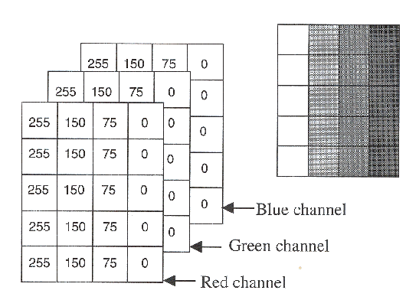
Raster Displays
Rectangular array (raster) of picture elements (pixels).
The goal of CG is to populate this array with the correct color values such that the final image conveys the desired look.

Slide 5
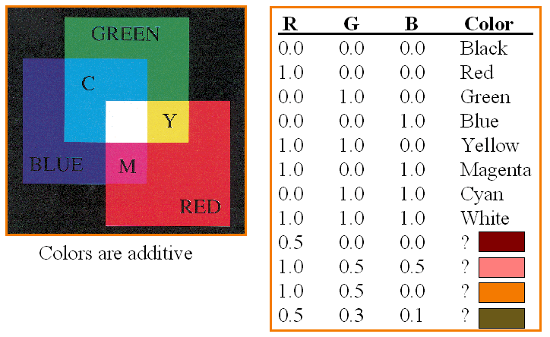
Raster Displays
Rectangular array (raster) of picture elements (pixels).

Slide 6
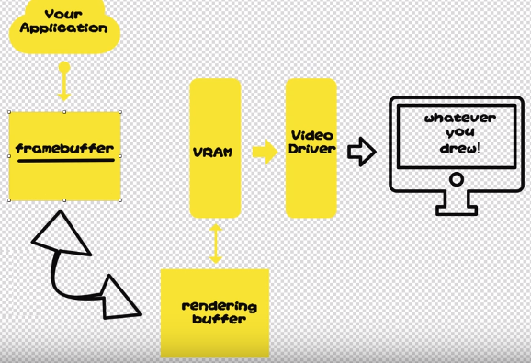
Raster Displays
Frame buffer, double buffering

Slide 7

Raster Displays
Generated images are sent to a display devices (CRT, LCD) through the video driver

Slide 8
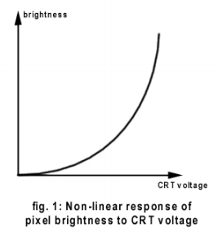
Raster Displays
Most display devices are not linear; i.e., there is a non-linear relationship between the input voltage and the output luminance
Luminance is a photometric measure of the luminous intensity per unit area of light travelling in a given direction //brightness

Slide 9
Raster Displays
This means that if you double a pixel value (i.e., the input voltage), you do not get twice the luminance

Slide 10
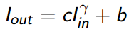
Raster Displays
This means that if you double a pixel value (i.e., the input voltage), you do not get twice the luminance
The relationship is generally modeled as:
c contract, b brightness, gamma of the display device
If we know gamma, we can correct our images before sending to the display device so that they appear correct to the viewer

Slide 11
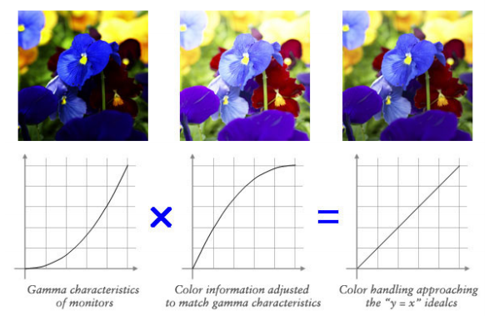
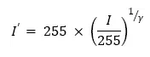
Raster Displays
If we know gamma, we can correct our images before sending to the display device so that they appear correct to the viewer
I: input intensity

Slide 12
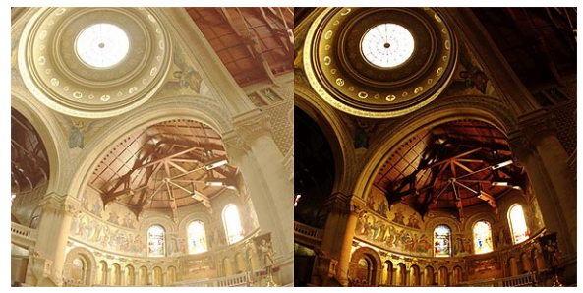
Raster Displays
With and without gamma correction:

Slide 13
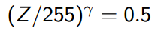
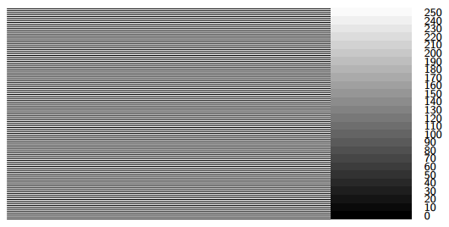
Raster Displays
To estimate gamma of the display device
Find the patch which matches in intensity to the blended value of the black-and-white stripes
Read out the corresponding pixel value, Z, and solve for

Slide 14
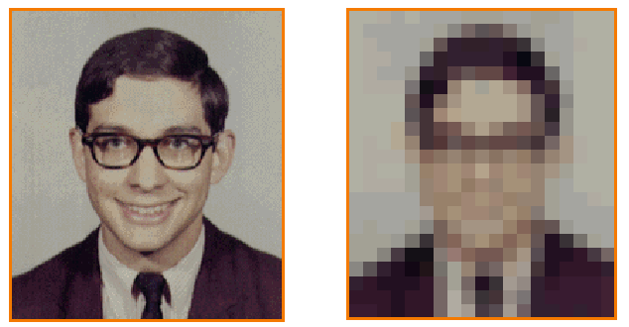
Image
An image is a 2D rectilinear array of pixels
Continuous image Digital image

Slide 15
Image
Pixels are samples from continuous function
Photoreceptors in eye
CCD cells in digital camera
Rays in virtual camera

Slide 16
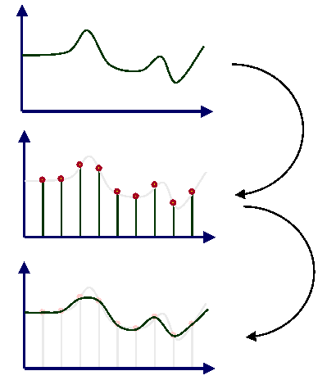
Image
Sampling brings errors
Errors due to limited intensity resolution //quantization
Errors due to limited spatial resolution //aliasing
Sampling
Reconstruction (errors introduced)

Slide 17
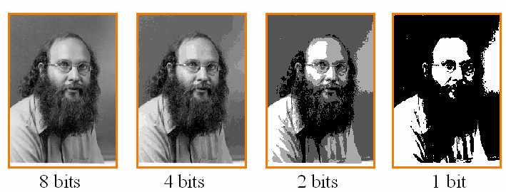
Image
Quantization
Images with decreasing bits per pixel:
(aka uniform quantization)
How many bits for a color image?

Slide 18
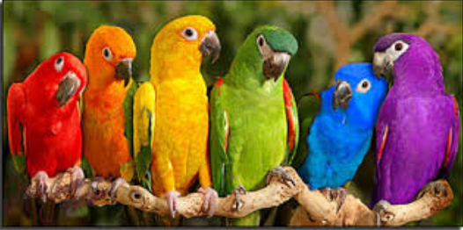
Image
Quantization
A color image (24 bpp)
How many bits for a color image?

Slide 19


Image
Aliasing
Use the average of neighboring intensities per pixel
Aliased:
Antialiased:

Slide 20
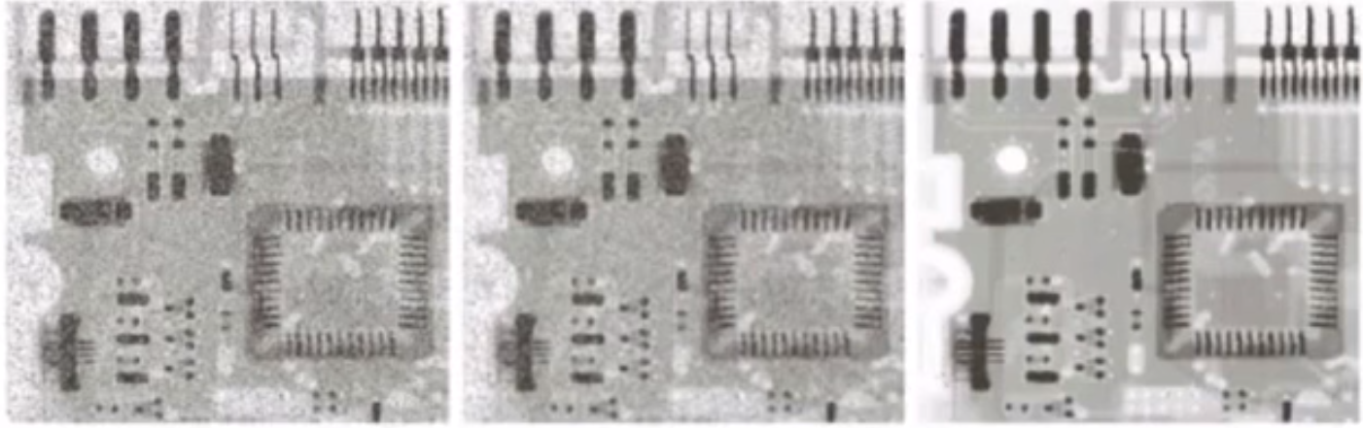
Image
More image processing tools
Filtering
Blurring
Noise reduction
Mean and median filters that reduce the noise, e.g., salt-pepper noise:
Warping
Scaling
Rotating
Deforming

Slide 21
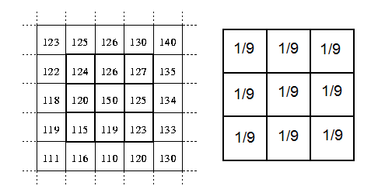
Image
More image processing tools
Filtering
Blurring
Noise reduction
Mean and median filters that reduce the noise, e.g., salt-pepper noise:
Warping
Scaling
Rotating
Deforming

Slide 22
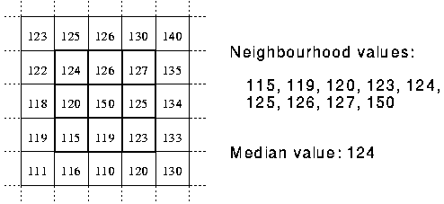
Image
More image processing tools
Filtering
Blurring
Noise reduction
Mean and median filters that reduce the noise, e.g., salt-pepper noise:
Warping
Scaling
Rotating
Deforming

Slide 23
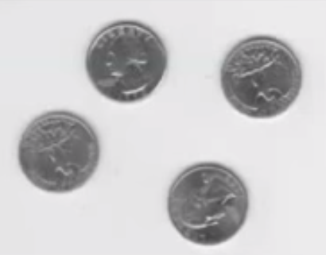
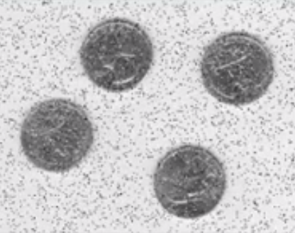
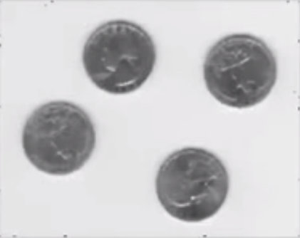
Image
More image processing tools
Filtering
Blurring
Noise reduction
Mean and median filters that reduce the noise, e.g., salt-pepper noise:
Warping
Scaling
Rotating
Deforming

Slide 24

Image
More image processing tools
Filtering
Blurring
Noise reduction
Mean and median filters that reduce the noise, e.g., salt-pepper noise:
Why works?
Warping
Scaling
Rotating
Deforming

Slide 25

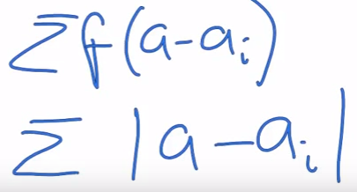
Image
More image processing tools
Filtering
Blurring
Noise reduction
Mean and median filters that reduce the noise, e.g., salt-pepper noise:
Warping
Scaling
Rotating
Deforming

Slide 26
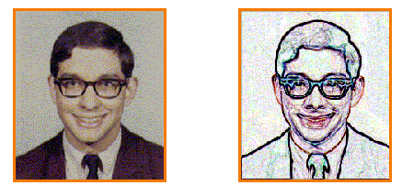
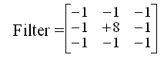
Image
More image processing tools
Filtering
Blurring
Edge detection
Filter that finds differences b/w neighbor pixels (high gradient = edge)
Warping
Scaling
Rotating
Deforming

Slide 27
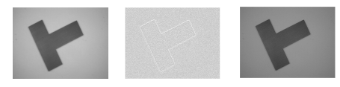
Image
More image processing tools
Filtering
Blurring
Sharpening
Edge/gradient image g(x,y) = f(x,y) – f_{smooth}(x,y).
f_{sharp}(x,y) = f(x,y) + k * g(x,y)
Warping
Scaling
Rotating
Deforming

Slide 28
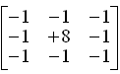

Image
More image processing tools
Filtering
Blurring
Sharpening
Edge/gradient image g(x,y) = use filter directly
f_{sharp}(x,y) = f(x,y) + k * g(x,y)
Warping
Scaling
Rotating
Deforming

Slide 29
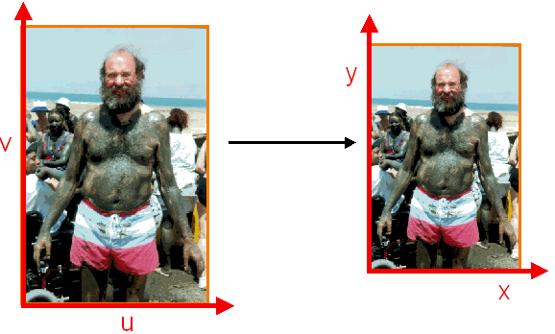
Image
More image processing tools
Filtering
Blurring
Noise reduction
Edge detection
Sharpening
Warping
Scaling:
Rotating
Deforming

Slide 30
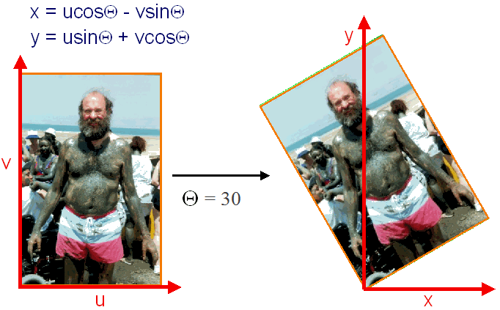
Image
More image processing tools
Filtering
Blurring
Noise reduction
Edge detection
Sharpening
Warping
Scaling
Rotating:
Deforming

Slide 31
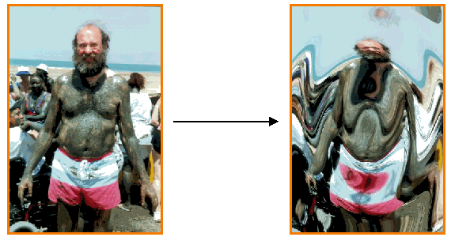
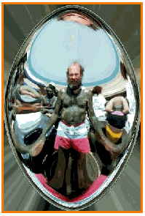
Image
More image processing tools
Filtering
Blurring
Noise reduction
Edge detection
Sharpening
Warping
Scaling
Rotating
Deforming: Warp Fish eye lens

Slide 32
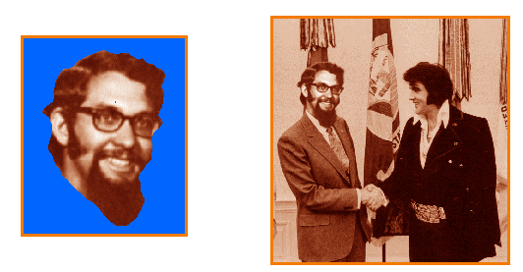
Image
More image processing tools
Compositing
Create background image
Create foreground image with blue background
Insert non-blue foreground pixels into background

Slide 33
Image
More image processing tools
Compositing
Blues work as transparent pixels (alpha=0), others opaque (alpha=1)
Apply weighted alpha for alpha matting (semi-transparent)
Color = (1-alpha)*foregroundColor + alpha*backgroundColor
Pixels with alpha channel: (r, g, b, alpha)

Slide 34
Image
Image formats
Typically images are represented with 8-bits per color channel giving rise to 24-bit pixels
Images may be displayed directly (by sending it to the video card) or may be stored in a standard format (for offline viewing)
There are hundreds of image formats, perhaps JPEG being the most commonly used
In this class, we’ll use a simple file format called PPM to store our images (for ray tracing)

Slide 35
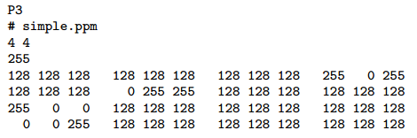

Image
PPM format
PPM is a very simple interleaved image format
It has two flavors namely text and binary and we will use the text version for further simplicity
Example:

Slide 36
Image
PPM format
Note that PPM is hugely inefficient as everything is stored as uncompressed ascii characters
What would be the size of an 18MP PPM image file?
18 × 1024 × 1024 × 3 × 3.57/(1024 × 1024) MB ≈ 192 MB
The last ×3.57 represents the expected value of the number of bytes that each component will occupy:
(10 × 1 + 90 × 2 + 156 × 3)/256 + 1 where the last +1 represents the space occupied by white space (or the newline character between rows)

Slide 37
Image
PPM format
Note that PPM is hugely inefficient as everything is stored as uncompressed ascii characters
What would be the size of an 18MP PPM image file?
If we had a binary file, the file size would be 18 × 1024 × 1024 × 3/(1024 × 1024) MB ≈ 54 MB as each component will be saved as a single byte and white spaces would not be stored
This is still lots of disk space for a single image
More efficient file formats such as JPEG, TIFF, and PNG occupy much less space due to compression

Slide 38
Image
Lossy vs. lossless formats
Some image formats are lossy meaning that they cannot reconstruct the original signal exactly
JPEG is a lossy file format (however, depending on the compression quality visually perceiving errors may be impossible)
TIFF can be both lossy and lossless depending on the selected options
PPM and PNG are lossless
Let’s convert our simple.ppm to JPEG to observe the difference

Slide 39
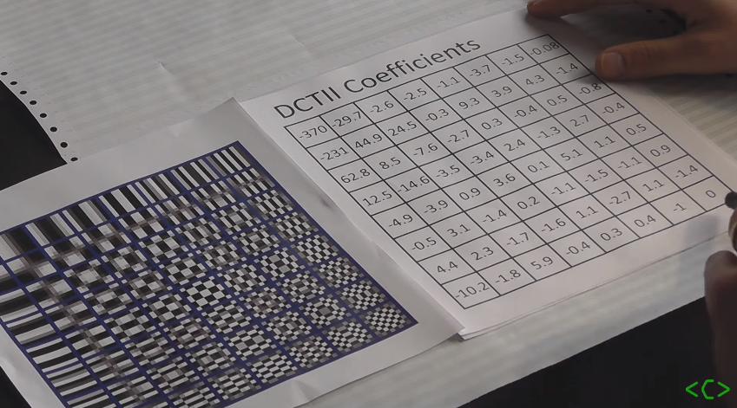
Image
JPEG format
Discrete Cosine Transform on each 8x8 block of the image
Ignore small coefficients

Slide 40
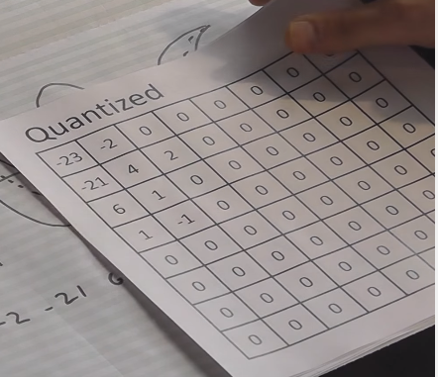
Image
JPEG format
Discrete Cosine Transform on each 8x8 block of the image
Ignore small coefficients, quantize

Slide 41
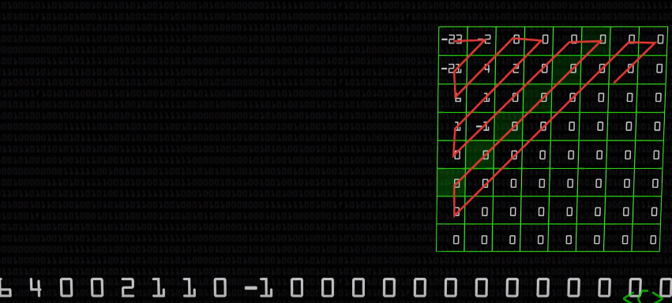
Image
JPEG format
Discrete Cosine Transform on each 8x8 block of the image
Ignore small coefficients, quantize, apply Huffman coding

Slide 42
Image
JPEG format
Discrete Cosine Transform on each 8x8 block of the image
Ignore small coefficients, quantize, apply Huffman coding
See https://youtu.be/Q2aEzeMDHMA for details

Slide 43
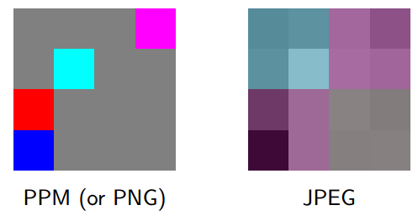
Image
Lossy vs. lossless formats

Slide 44
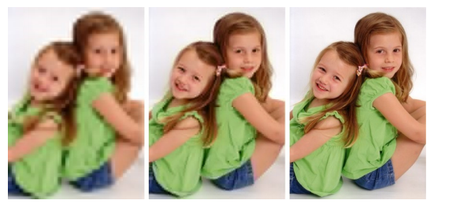
Image
A JPEG with different quality settings

Slide 45
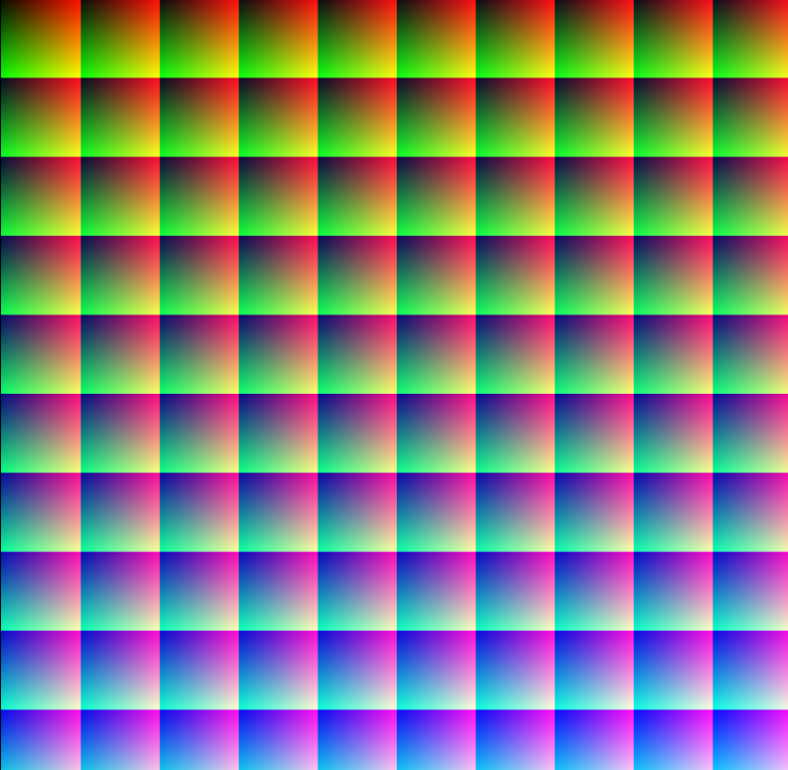
Perception
Human eye can distinguish about 10M different colors.

Slide 46
Perception
Electromagnetic spectrum.
Bees and many other insects can detect ultraviolet light, which helps them to find nectar in flowers.
Bees’ visible spectrum, however, ends at about 590 nm, just before the orange wavelengths start.
Birds, however, can see some red wavelengths, although not as far into the light spectrum as humans.
Human spectrum: red (700nm) to violet (400nm).
Goldfishes can see ultraviolet light (10nm).

